Slide 1
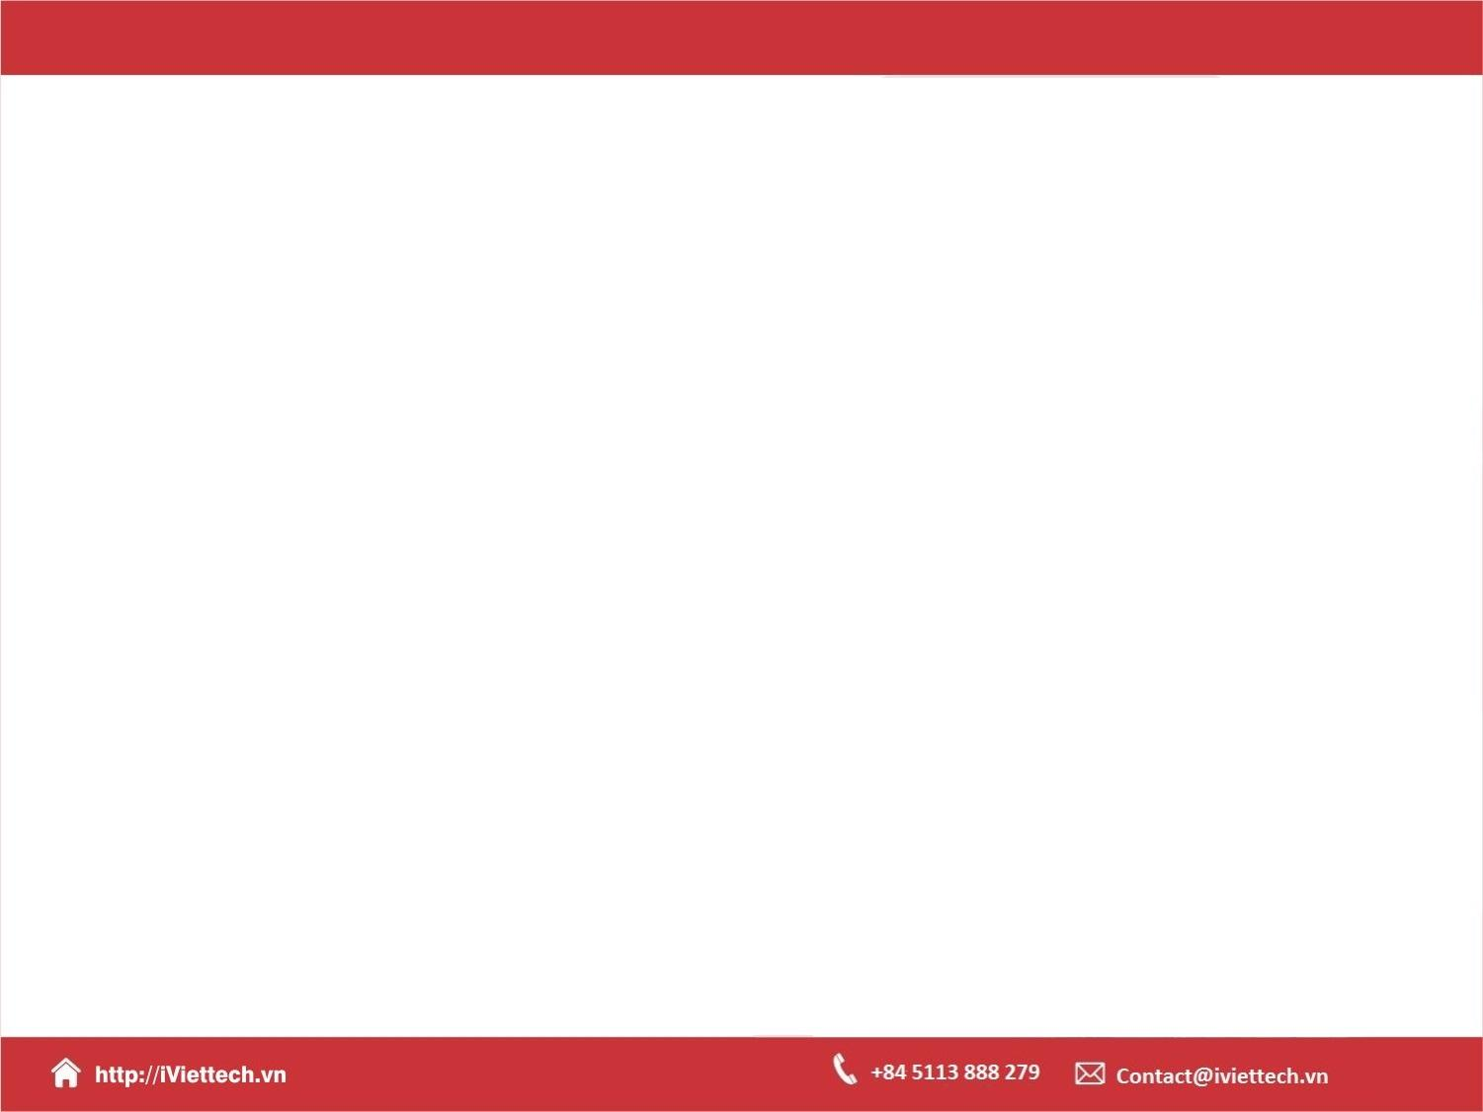
Chapter 16
Using a Frontend JavaScript Library with Django

Slide 2

Objectives
This chapter introduces the basics of JavaScript and ends with building an interactive web frontend for Bookr using the React JavaScript framework.
You will learn how to include the React JavaScript framework in a Django template, and how to build React components.

Slide 3
JavaScript Frameworks
Without a framework, you would need to do all these things yourself:
Manually define the database schema.
Convert data from HTTP requests into native objects.
Write form validation.
Write SQL queries to save data.
Construct HTML to show a response

Slide 4
Add a Static JS File
Adding js files in Django project is done exactly the same way as adding css files in Django:
Static files, like css, js, and images, goes in the static folder. If you do not have one, create it in the same location as you created the templates folder:

Slide 5
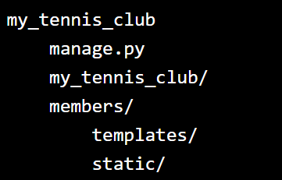
Add a Static JS File

Slide 6
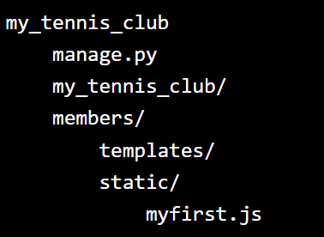
Add a Static JS File
Add a .js file in the static folder, name it myfirst.js:

Slide 7
Add a Static JS File
members/static/myfirst.js:
function myFunction() {
alert("Hello from a static file!");
}

Slide 8
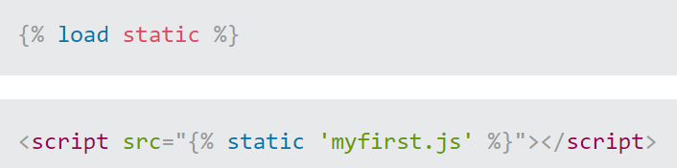
Modify the Template
Now you have a js file, with a JavaScript function. The next step will be to include this file in a HTML template:
Open the HTML file and add the following:

Slide 9
Modify the Template
Now you have a js file, with a JavaScript function. The next step will be to include this file in a HTML template:
Open the HTML file and add the following:

Slide 10
Modify the Template
And, add a button with a onclick event that triggers the function:

Slide 11
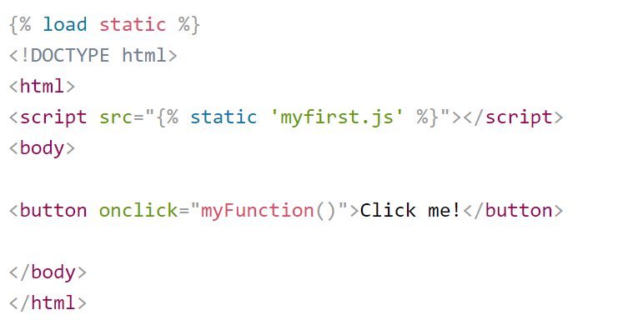
Example

Slide 12
Summary
In this chapter, we introduced JavaScript frameworks and described how they work with Django to enhance templates and add interactivity.
We introduced the JavaScript language and covered some of its main features, variable types, and classes.
We then introduced the concepts behind React and how it builds HTML by using components.

